Slide 1
TraVis – A Visualization Framework for Mobile Transect Data Sets in an Urban Microclimate Context

Slide 2
Motivation
In urban microclimate research, mobile transects are utilized to observe the relationship between atmospheric variables and the urban environment.
Ex – Urban Heat Island, Thermal Comfort, etc.
Resulting data sets are complex: spatially dependent, multivariate, and often-times multitemporal.
These properties make analysis and visualization challenging.

Slide 3
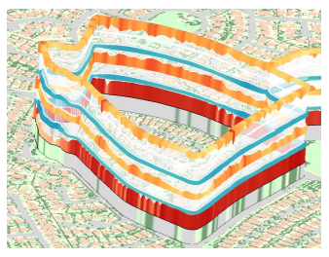
Aim
Prototype Framework.
To build a visualization framework for the analysis of mobile transect datasets.
Hybrid 2D/3D representation using wall layers stacked in z-direction on a 2D LULC (land use/land cover) map.
To understand multi-variate trajectory data, providing a detailed view of their dynamic behavior.
Interactive clustering interface to classify transect segments.

Slide 4
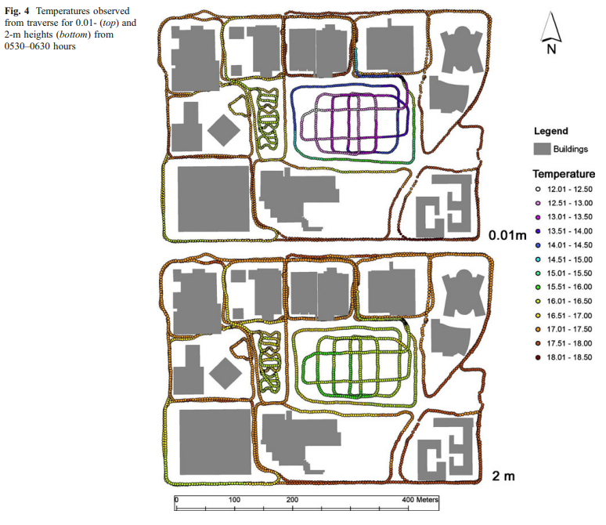
Related Work
Mobile urban climate transect measurements
Chow used this to study nocturnal park cool island effect on the ASU campus in Tempe, Arizona.
Visual analytics for geospatial trajectory data sets
Car Movement dataset clustering
TrajectoryLens – spatial filter for large trajectory data sets.
Notes:
mobile measurements at four heights to derive temperature profiles over a variety of surface types to investigate the characteristics of the nocturnal park cool island effect on the ASU campus in Tempe, Arizona.
Using three different kinds of TrajectoryLenses, a user can investigate the set of trajectories with common starting points, end points, intermediate route points, or a combination of these. A temporal filter can also be applied to the data by selecting an interval on a hierarchical time slider.

Slide 5
Methodology
Data Preprocessing,
SQL Database, Geographical Information System georeferencing, LULC Map information.
Data Representation,
a high-resolution 2D LULC map, third dimension to display stacked attributes, Color Schemes, Inversion and Spatial Context.
Notes:
Data transformation also includes Geographical Information System (GIS) georeferencing, projecting the attribute observations into the coordinate system of the spatial context maps. In our case, the GPS positions are given as geographical coordinates and projected into a UTM conformal projection to store all data in a Cartesian reference space. The GIS coordinate transformations are carried out using the open-source GDAL library [12].
we extract the LULC type directly underneath the sensor platform location from a high-resolution LULC map [10] and store them as additional attribute in the corresponding tables, i.e. each measurement tuple is complemented with the LULC information/

Slide 6
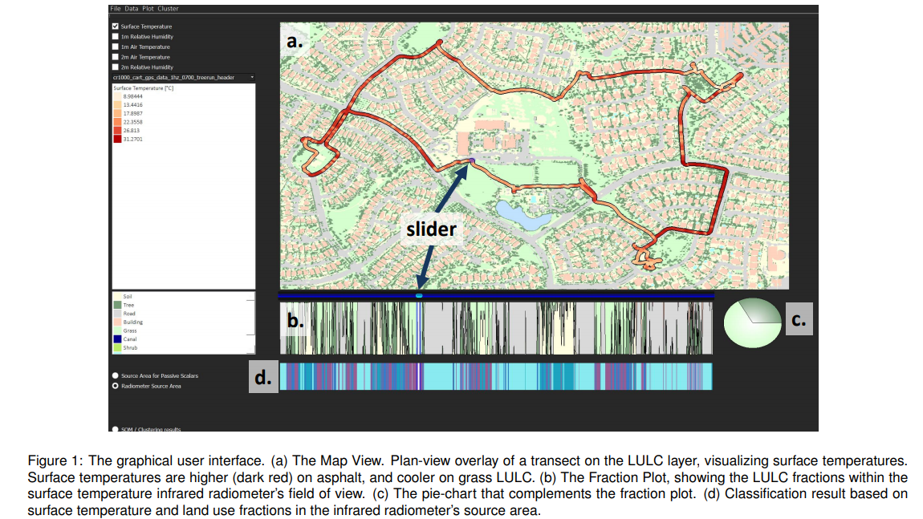

Slide 7
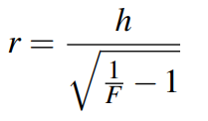
Methodology
Analyzing the impact of the spatial context on attribute values,
Theoretical considerations – Source Area.
Fomula - where r is the radius of the source area and h is the height of radiometer, F is dimensionless view factor. (95% usually)
Visualization – Using a slider to select the transect segment.
Classifying segments of the transect.
K-means and Self-Organizing Maps.
Notes:
the source area is a circular area that is the field of view of the instrument,
F is the dimensionless view factor that describes the ratio between a circular area on the ground and its surrounding annulus (limited by the horizon for a radiometer with a field of view of 180) [29]. In our implementation, F is constantly set to 0:95, which means that the elements located within the resulting disc contribute to 95 % of the measured surface temperature signal [24].
Since the source area needs to be estimated for each node on each trajectory, the estimation technique must be computationally affordable. Therefore, we rely on Schmid’s simple parametric model to determine a source area’s shape and size [28]
For the prototype described in this paper, the orientation of the source area was estimated using averaged wind direction values retrieved from four weather stations surrounding the study area [22]. The other necessary parameters were selected such that the final ellipsoid approximates a realistic size.

Slide 8
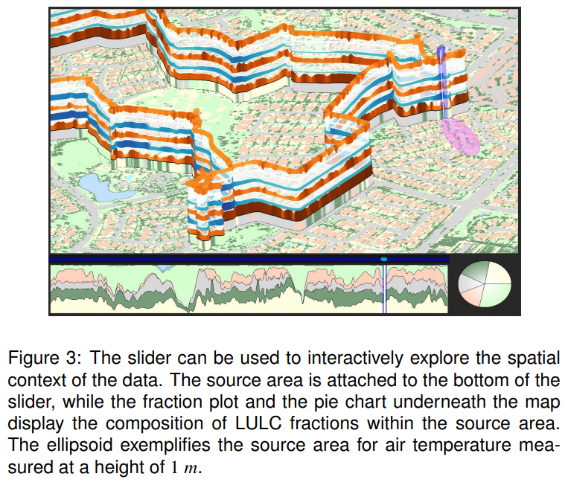
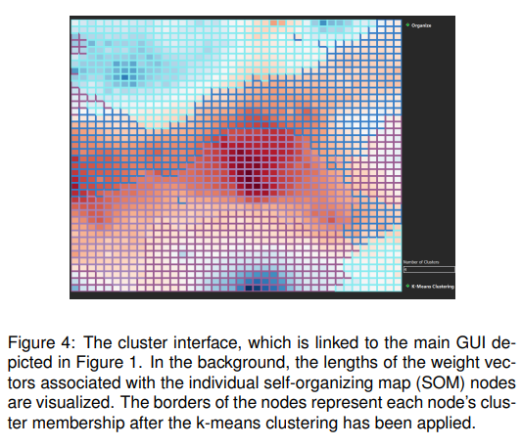
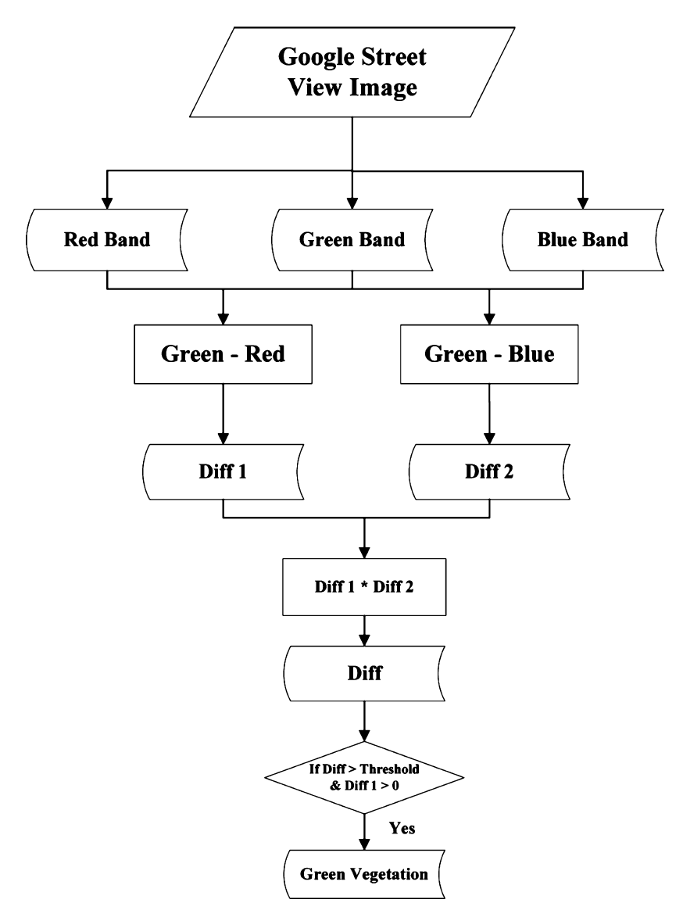
Notes:
Sensor height wall in close up view, showing a segment of a transect run included in our sample data set: surface temperature, 1 m relative humidity, 1 m air temperature, 2 m relative humidity, and 2 m air temperature (from bottom to top). The lowest layer shows the LULC class of the particular route nodes; trees dark green, soil/gravel yellow, grass light green, hardscape light grey. Note the visual pattern of association between LULC, temperature, and humidity.
AGL, wind speed and direction, and atmospheric factors determine the shape and position of the source weight function,

Slide 9
Case Study -
A mobile transect data set recorded on May 08, 2014, between 14:40 and 15:50 MST using a sensor platform mounted to a golf cart.
Surface temperature, air temperature in 1 and 2 m and relative humidity in 1 and 2 m were sampled with a frequency of 1 Hz.
Power Ranch, located in Gilbert, Arizona, USA.
Normalized values for air temperature at 1 m and 2 m, relative humidity at 1 m and 2 m, and surface temperature as input for the SOM(1600 nodes).
Clusters - soil, grass, tree, asphalt, building, and water (swimming pool and lake).
Notes:
These results show that in general the algo-rithm can delineate the green vegetation although some artificial green features were classified as green vegetation. However, in real applications, considering the fact that artificial green features only possess a small portion of cityscapes, the misclassification results should have no much influence on the subsequent further analysis

Slide 10
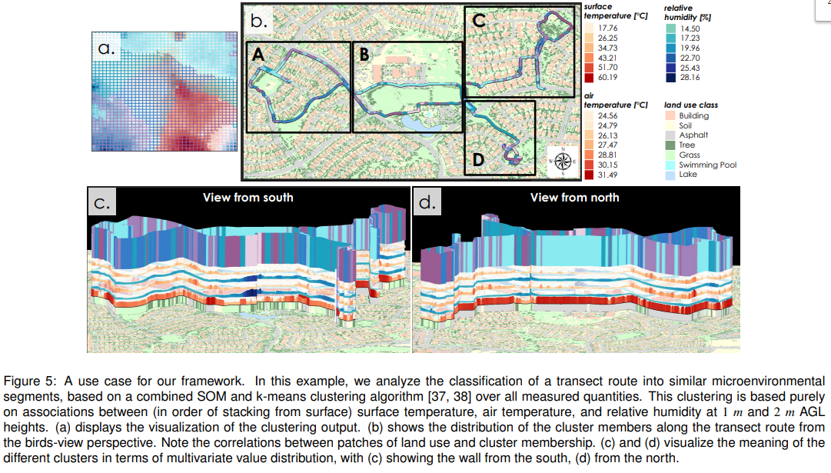
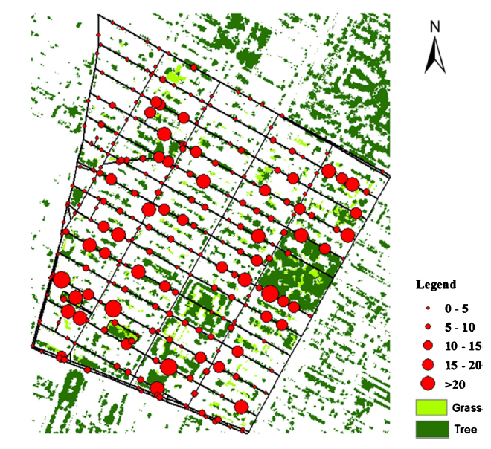
Histogram distribution of GVI in the study area
Out of 258, only 21 have GVI >15
Most of the high GVI sites located in southwest and northeast of East Village.
Notes:
To investigate this further, we rotate the map to visually explore the meaning of the different clusters (Fig. 5c/d). Since the rotation reveals the value distribution of all selected attributes, we can relate the clusters to the multivariate value distribution shown on the stacked ribbons (also compare Table 1). Using this technique, we observe that the seemingly isolated segments belonging to cluster 6 near the lake in part B and in the south-eastern park (part D). This cluster corresponds to exceptionally high humidity (Fig. 5c, Table 1), presumably owing to the lake’s open water surface evaporation and increased evapotranspiration in the park in part D.
Interestingly, park areas with grass LULC are associated with different microenvironmental clusters. Cluster 3 occurs near the lake in part B (Fig. 5b), in the north-eastern park (part C), in the park in the southern part of D, as well as during a small segment in the western park (western part of A). It is associated with a typical value distribution for vegetated areas, especially in terms of the low surface temperature. However, park areas are not consistently represented by cluster 3. Thus, the northern part of the park in part B largely belongs to cluster 2, which is defined by high surface temperatures (Fig. 5b, d, Table 1). Cluster 2 corresponds to the microenvironment of an asphalt-dominated LULC type that is adjacent to, and under the influence of, a grass covered park area. The same holds for the northern part of the park in the western part of A.
two park stretches in the southern part A and in the center of part D also belong to two different clusters. This can be explained by a difference in relative humidity, which is higher in the park stretch in part D (Fig. 5c).

Slide 11
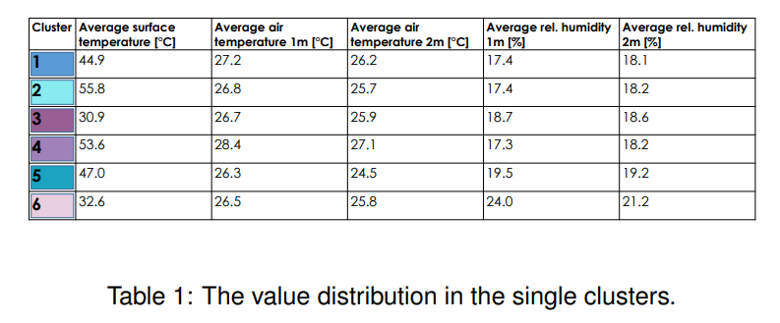
Two arrays of buildings area - cluster 4, defined by high surface temperatures due to the asphalt cover, high air temperatures, and low relative humidity.
Cluster 2 corresponds to the microenvironment of an asphalt-dominated LULC type that is adjacent to, and under the influence of, a grass covered park area.
Cluster 3 is associated with a typical value distribution for vegetated areas, especially in terms of the low surface temperature.
Cluster 6 corresponds to exceptionally high humidity, presumably owing to the lake’s open water surface evaporation and increased evapotranspiration in the park.
Notes:
However, park areas are not consistently represented by cluster 3. Thus, the northern part of the park in part B largely belongs to cluster 2,

Slide 12
Limitations
Computation time for SOM and K-Means.
Initialization Problem.
Wind Direction from surrounding weather station as a factor for Source Area.
Need more data about atmospheric stability.
Passive Scalar(Air Temperature) Source Area Shape estimation
More source area models needed for height maps and canopy structure.
Difficult visualization to understand at the first viewing.
Notes:
only provides a static environment of urban spaces, that is to say, the urban environment at the exact moment each photo was taken. Considering the facts that street greenery varies throughout the year and the urban environment tis a dynamic surrounding, therefore, the calculated GVI values will potentially be dependent on the time of year GSV images were taken and be affected by changes in weather, or other things moving around such as cars and people. Recently Google added time stamp to the GSV, but time information is still not accessible using GSV image
covers a limited num-ber of viewing points, which cannot capture the greenery from all places in a city. The greenery captured by GSV is limited to the greenery that can be seen from streets

Slide 13
Summary – In a nutshell
A prototypic framework for the visualization and analysis of mobile environmental transect measurements
Each measured attribute is visualized as a three-dimensional ribbon, whereas height and color emphasize the values measured at a particular location. Vertical stacking.
Slider and Clustering Functionality.
Reviewed the Case Study of Gilbert Arizona to determine meaningful clusters from the surveyed environments.
Future work would involve including temporal dimension into the visualization and clustering.
Notes:
Multivariate relationships between measured attributes could easily be detected, physically meaningful clusters determined, and connections between land use and observations drawn
If more transect runs have been conducted on a similar route, the individual points on the trajectories have to be registered, so that the behavior of the measured variables at certain locations can be compared over time. We also plan to add the capability to evaluate multiple types of spatial context such as the height map of the urban environments features.

Slide 14
Thank You

